Slide 1
GEORGIA and The PM3 Planning Process
Presented By:
Sheldon Harrison, Cambridge Systematics, Inc.
Other Contributors
Habte Kassa, Georgia DOT
Praveen Pasumarthy, Cambridge Systematics, Inc.
June 4, 2019

Slide 2
PM3 Overview
MAP-21/FAST Act
PM3 Rule/System Performance Rule
Purpose
Six (6) Performance Measures
Reporting Requirements
Targets Setting Requirements
Performance Measures for 2016 and 2017
Target Setting Process
Recommended Targets

Slide 3
Performance Measures
System Performance
Interstate Travel Time Reliability Measure
Freight
Truck Reliability Measure
CMAQ
PHED Measure
Non-Interstate Travel Time Reliability Measure
Non-SOV Travel Measure
Emissions Measure

Slide 4
Georgia
Performance Measure | Geographic Extent | Applicable Roadways | Timeframe
Percent of person-miles traveled on the Interstate that are reliable | Statewide | Interstate | 2-year and 4-year targets
Percent of person-miles traveled on the non-Interstate NHS that are reliable | Statewide | Non-Interstate | 4-year target
Truck Travel Time Reliability (TTTR) Index | Statewide | Interstate | 2-year and 4-year targets
Annual Hours of Peak Hour Excessive Delay (PHED) Per Capita* | Atlanta Urbanized Area | Entire NHS | 4-year target
Percent of Non-Single Occupancy Vehicle (SOV) Travel* | Atlanta Urbanized Area | All Roads | 2-year and 4-year targets
Total Emissions Reduction | Statewide | All Roads | 2-year and 4-year targets
*: GDOT, Atlanta Regional Commission and Cartersville-Bartow Metropolitan Planning Organization are required to establish and report single targets

Slide 5
PM 3.0 Target Setting Process
Review external factors
Travel demand, economic trends, population
Review internal factors
STIP
Conduct trend line analysis
Set targets using a conservative approach
Targets likely easier to achieve when conservative
Lack of extended historical data
External factors may influence developments beyond control of local planning

Slide 6
Status in Georgia
Already had CMAQ Calculator from prior work
Python based along with Excel calculator spreadsheet
Provided PHED
% Non-SOV and Total Emissions Reductions entered from other tools
Originally used HERE as input data for speeds
Converted to use NPMRDS
Different data format and assumptions
Required reformatting of tool

Slide 7
RITIS Tool
RITIS Tool became available in 2018; Use for:
System Reliability
Freight Reliability
PHED
Overlap with Calculator
For consistency with the other link based reliability metrics
Minor differences between Calculator outputs and RITIS
Slightly different geographic extent used, peak hour travel factors, occupancy etc.

Slide 8
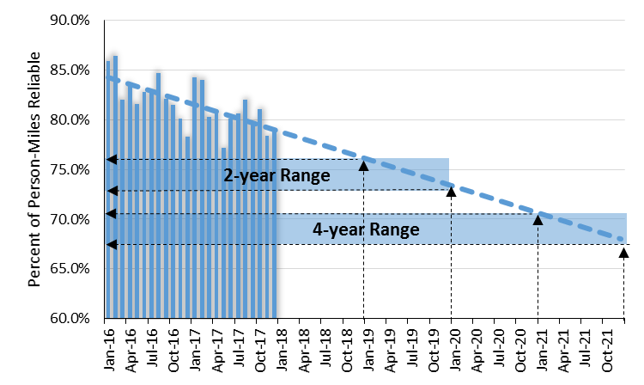
Interstate Person-Mile Reliability
A downward trend represents decreasing performance

Slide 9
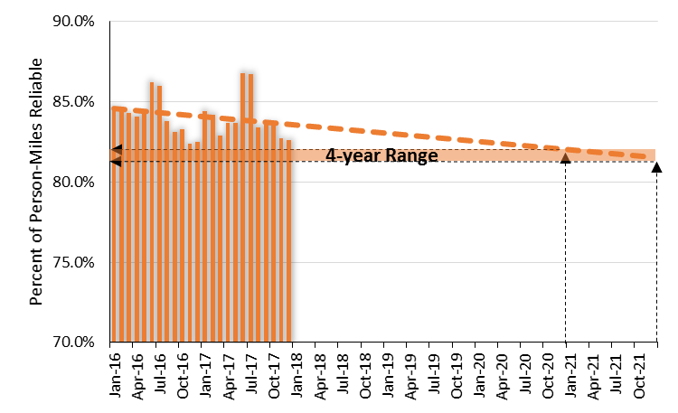
Non-Interstate NHS Person-Mile Reliability
A downward trend represents decreasing performance

Slide 10
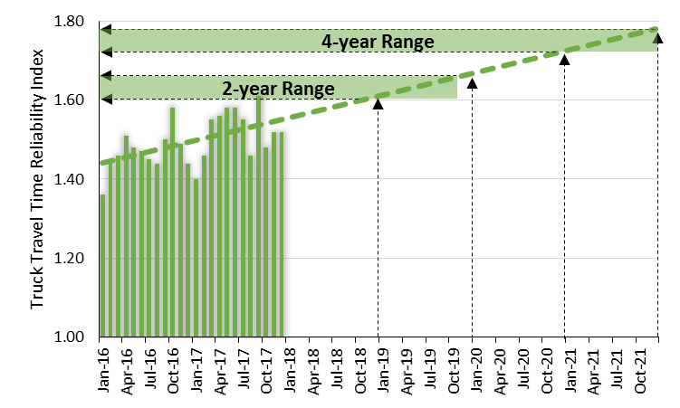
Truck Travel Time Reliability
An upward trend represents decreasing performance

Slide 11
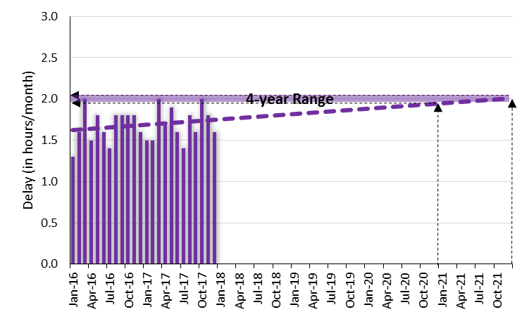
Peak Hour Excessive Delay
An upward trend represents worsening delay per capita

Slide 12
Adopted Targets
Performance Measure | 2-year Target | 4-year Target
Percent of person-miles traveled on the Interstate that are reliable | 73.0% | 67.0%
Percent of person-miles traveled on the non-Interstate NHS that are reliable | n/a | 81%
Truck Travel Time Reliability (TTTR) Index | 1.66 | 1.78
Annual Hours of Peak Hour Excessive Delay (PHED) Per Capita | n/a | 24.6 hours
Percent of Non-Single Occupancy Vehicle (SOV) Travel | 22.1% | 22.1%
Total Emissions Reduction | VOC: 205.700 kg/day; NOx: 563.300 kg/day | VOC: 386.600 kg/day; NOx: 1,085.000 kg/day

Slide 13
Key Lessons
Coordinate early and often with all stakeholders
MPOs, State DOT, FHWA and others
Monitor Federal guidance closely and be prepared to act quickly when updates are released
Next round should be smoother as the kinks in the process get worked out
Encourages coordination amongst stakeholders
Particularly good approach for short to medium term planning

Slide 14
Thank You
Questions?
sharrison@camsys.com

